Slide 1
MOS Virtual Show Table – September 17, 2020

Slide 2
Miltonia spectablis var. moreliana. (Fay Citerone) From Bob & Susan Travers

Slide 3
Habenaria rhodocheila 'Brilliant’ - Fay Citerone from Sarah Hurdel

Slide 4
yellow Vanda – Marilyn Lauffer

Slide 5
Milt. Lillian Nakamoto – Marilyn Lauffer

Slide 6
Phalaenopsis - Judi von Mehlem

Slide 7
Oncidium 'Sherry Baby' Sweet Fragrance – Bob Travers

Slide 8
Lc. Sagarik Wax - Kathi Jackson

Slide 9
Phal. Summer Rose ‘Blue Star’ - Kathi Jackson

Slide 10
Phal Cassandra - Maria and Norm Zickuhr

Slide 11
Pragmipedeum Hanna - Maria and Norm Zickuhr

Slide 12
Guilded Tower 'Mystic Maze'- Sarah Spence

Slide 13
Phal. Summer Rose 'Blue Star' - Pat Schiavi

Slide 14
Phal. Taida King's Caroline 'Taida Little Zebra' - Pat Schiavi

Slide 15
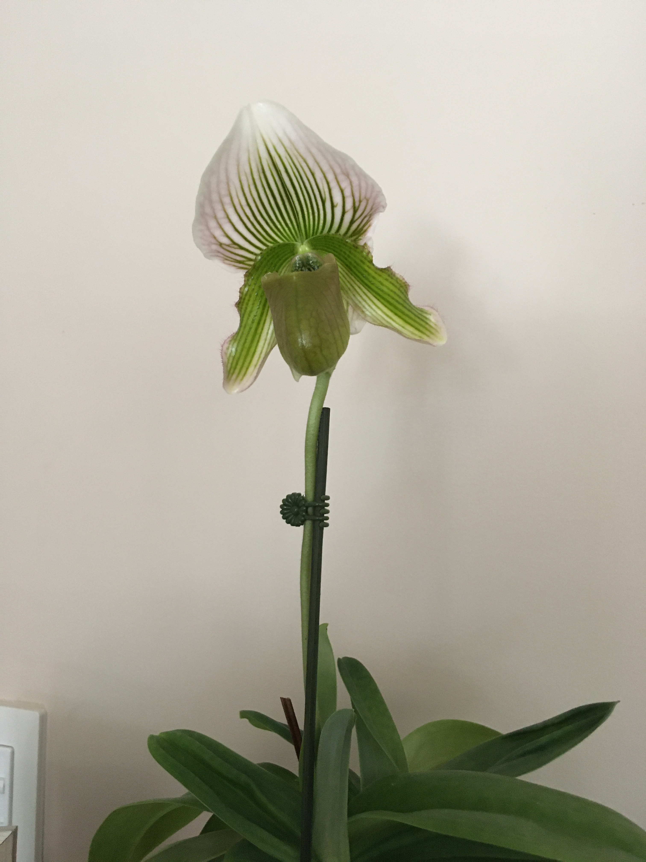
Paph. Heron’s Faire (White Heron ‘Giant’ x fairreanum fma album ‘Lime White’) - John Heinbokel

Slide 16
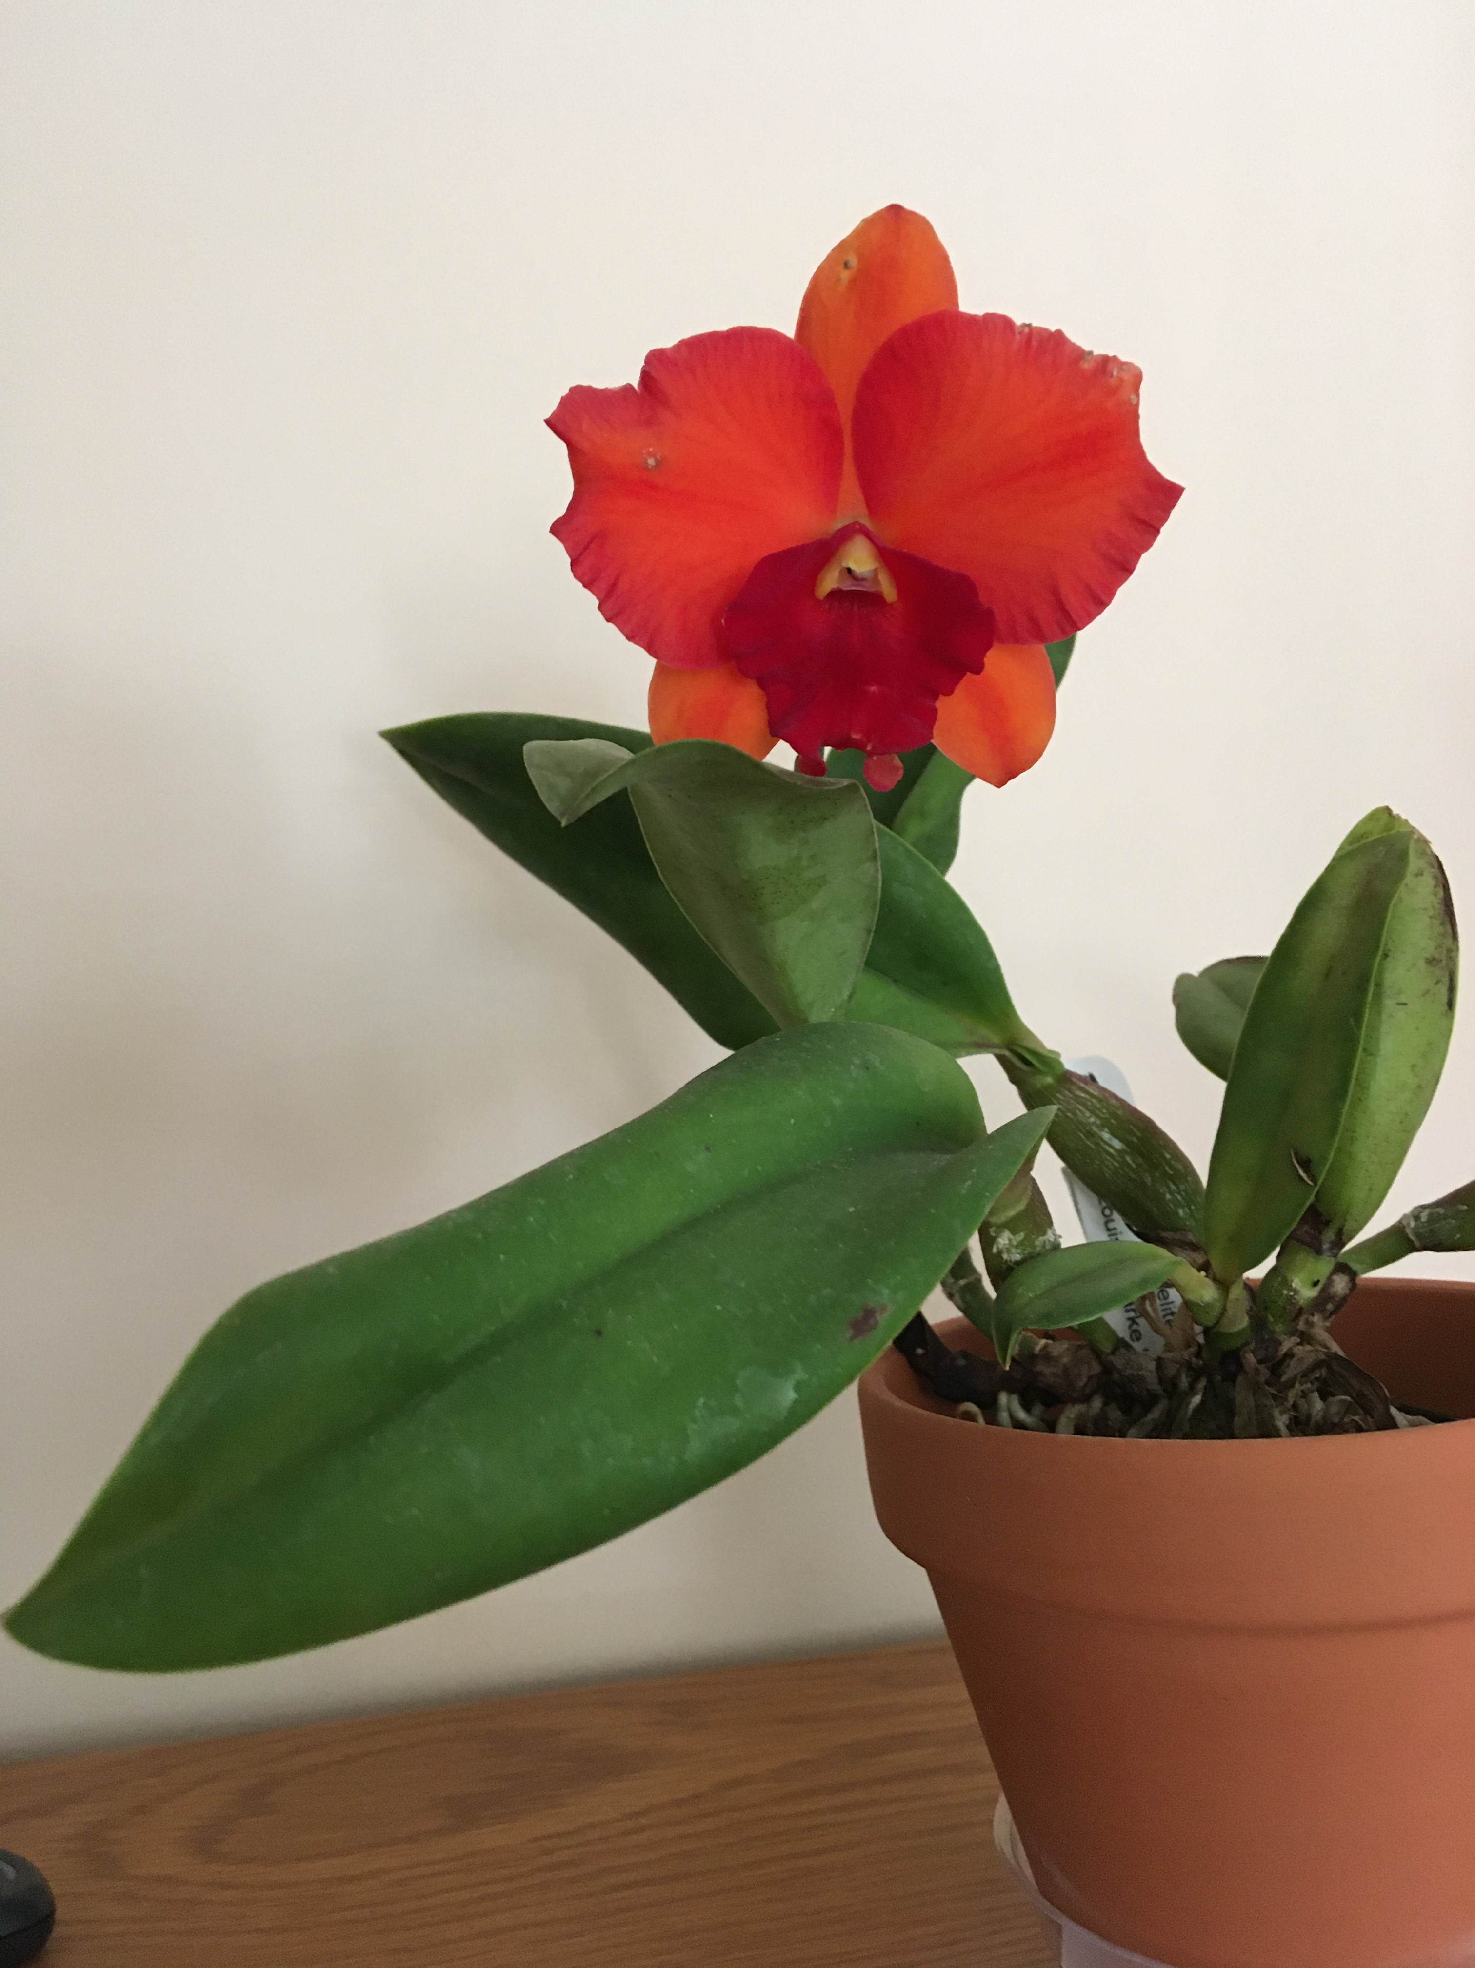
Slc. Cosmic Delite ‘SVO’ HCC/AOS x Pot. Louise Clarke ‘Outstanding’ - John Heinbokel

Slide 17
Brassavola perrinii – Arne Schon

